Slide 1

Tips and Tricks for Budgeting Your Local Health Department
August 2026
Timothy McDonald
Director, Needham Department of Health and Human Services

Slide 2
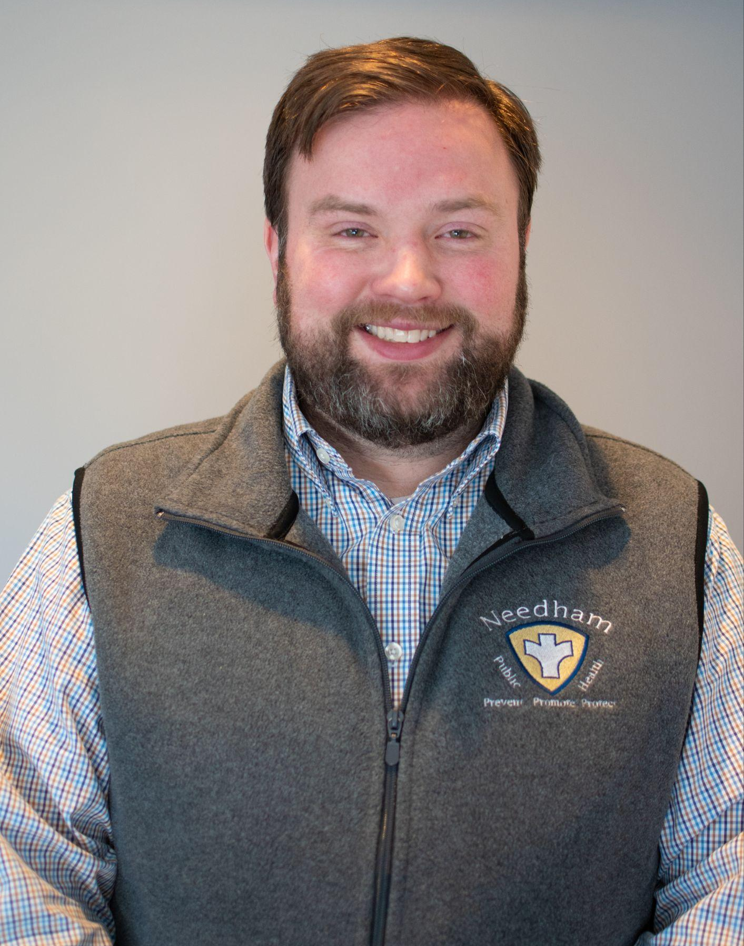




Introduction
My experience:
City of Boston
MA DPH
Town of Needham
MHOA
Timothy McDonald
Director, Needham Department of Health and Human Services

Slide 3
Learning Outcomes
By the end of this session you will be able to…
1
2
3
Describe best practices for budget planning and development
Explain the municipal budgeting process
Plan for budget cuts and staffing changes
Notes:
What you will do today

Slide 4
“Don't tell me what you value, show me your budget, and I'll tell you what you value.”
Joe Biden
Notes:
Why do you like budgeting? Why is it important for public health officers?

Slide 5
Managing a Budget:
Step 1: Know your system
Step 2: Know your budget resources

Slide 6
Step 1: Know Your System
    Your form of municipal government decides how readily you can amend an operating budget and how often funding can be appropriated.
Town Model
Town Meeting is the legislative body
Difficult to revise budgets
What you don't get in the base budget, you likely can't add until next fiscal year
City Council
Slightly different from Town model
More frequent meetings
Easier to amend existing budgets
You can be more opportunistic, but you also have to be ready to justify an ask on short notice

Slide 7
Step 2: Know Your Budget Resources
What is a budget?
The money available for, required for, or assigned to a particular purpose
The tools you have the finance your program
Different categories give you different kinds of flexibility
Operating
Revolving/Donation
Capital
Opioid Settlement
Grant
Trust Funds

Slide 8
Step 2: Know Your Budget Resources
    Municipal budget: The municipality's entire annual appropriation.
Every department, plus schools, debt service, revolving and enterprise funds, utilities, etc.
Public health is one line in the municipal budget, or maybe its part of a larger Health & Human Services budget or a Community Services Department budget

Slide 9
Step 2: Know Your Budget Resources
Operating budget: Appropriations for the ordinary maintenance or administration of activities for the fiscal year (July 1 - June 30).
Divided into three categories:
  Salary (can’t cross the line)
  Expenses (can’t cross the line)
  Operating capital (also separate bucket)
Base budget: Also known as level-service budget. Assumes that you will provide the same level of services from one year to another. Increases or decreases to the budget are based on fluctuating costs or adjustments (like COLAs and step raises) to continue to provide the same service.

Slide 10
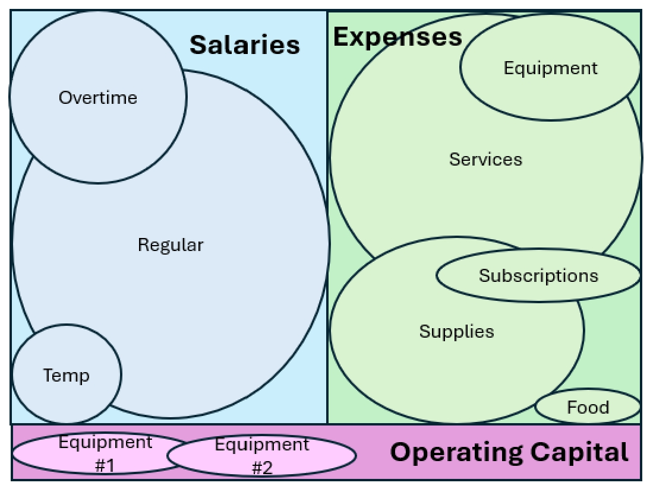
Step 2: Know Your Budget Resources
Operating budget (continued)
The bottom-line budget for salaries, expenses, and operating capital, respectively, cannot be overspent.
The individual line items within three categories can fluctuate, as long as it balances.

Slide 11
Step 2: Know Your Budget Resources
Capital budget: One-time purchases of durable assets above the municipality’s capital threshold.
Funded outside of the operating budget, often though free cash, borrowing, or a capital stabilization fund
If it lasts more than a few years and costs more than your municipality’s threshold, put it in the capital plan, not expenses
  Thresholds vary by municipality. Ask your Finance contact for the number in writing before building next year's request.
  Capital plans run on a rolling five‑year time horizon. Getting a vehicle into year five of the capital plan today is heckuva lot easier than finding the money in year one.

Slide 12
Step 2: Know Your Budget Resources
Grant funds: Money awarded for a defined scope and period.
Restricted to the purpose in the award, but the restriction is a conversation
With funder approval, you can cross the line. Budget amendments and no-cost extensions are routine.
Spending the award
Read the terms before spending
Flag variance at the halfway point
Get the approval in writing
Never assume it renews

Slide 13
Step 2: Know Your Budget Resources
Revolving and Donation funds: Revolving accounts are fed by the fees of the program they support (e.g., vaccinations, clinics). Donation accounts hold money given for a stated purpose.
Beneficial for program costs and per diem help, risky as the foundation for a permanent position
These funds do not retain interest, interest accrues to the municipality’s general fund
Rolls over year-to-year (“durable” funding)
Restrictions on full-time salary and fringe for revolving funds
Annual spending cap is set by a vote of the legislative body (Town Meeting or City Council)

Slide 14
Step 2: Know Your Budget Resources
Opioid Settlement funds: Your municipality’s share of state or federal opioid settlements, paid out over years and restricted to approved abatement uses.
Retains interest within the fund and rolls over year-to-year
Use these funds for commitments longer than a single fiscal year and document the abatement justification for every dollar
Because these funds are public and public reporting is required, settlement spending is an excellent storytelling tool with your Select Board and residents

Slide 15
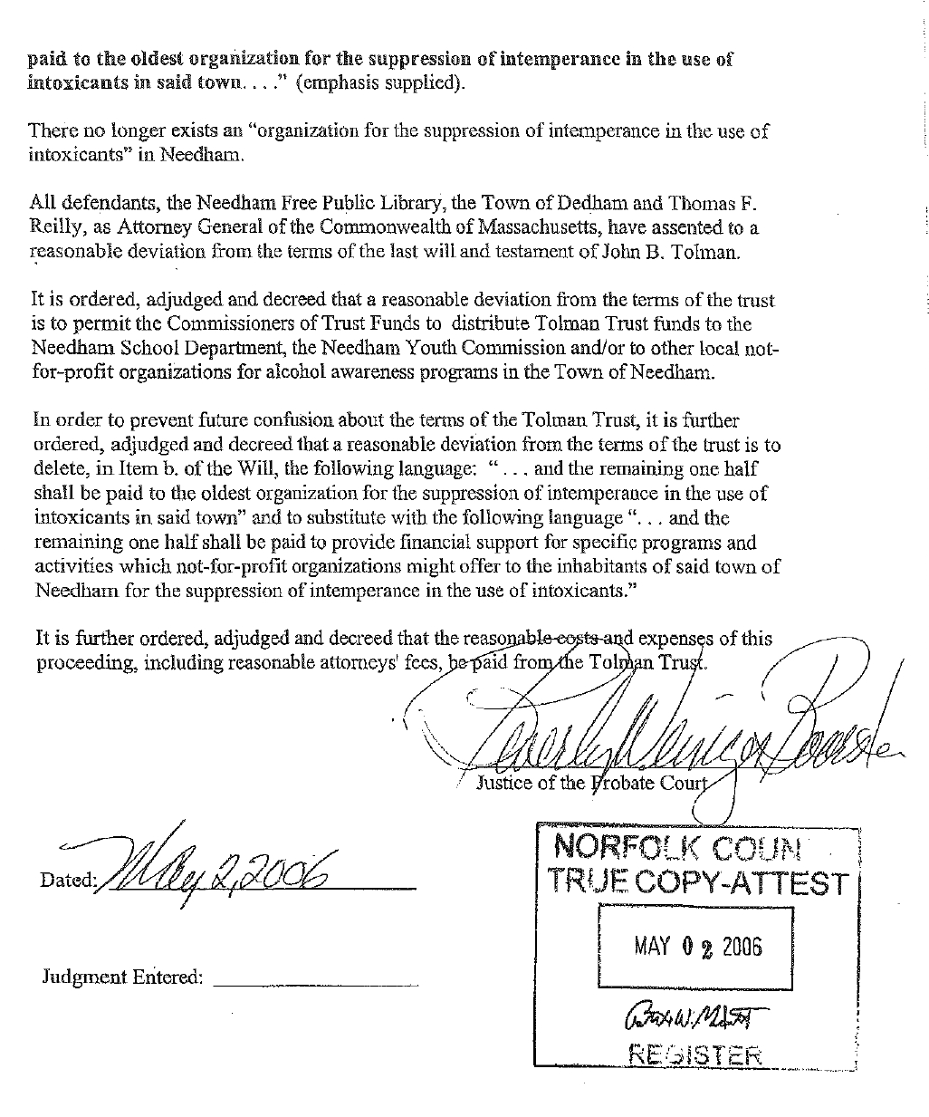
Step 2: Know Your Budget Resources
Trust funds: Gifts and bequests held by the town under the terms of the original instrument.
Retained interest
Find the original document and read it
Institutional memory shrinks the purpose over time, work with the Treasurer and Town Counsel to confirm the real terms

Slide 16
Managing a Budget:
Best Practices for Budget Planning and Development

Slide 17
Managing a Budget
Budget management strategies, at different scales…
Project or Program
One scope
One funding source
One timeline
Department or Division
Many scopes
Many funding sources
Competing timelines

Slide 18
Project Management
    Have multiple plans for how you spend
Name the deliverables the money is paying for and when they will be completed
Avoid making decisions under pressure: Write down in advance what you will do if you are 20% under spent at the midpoint of the fiscal year
Procurement often takes longer than expected: Build a plan backwards from the deliverable due date to spend down all of your funds

Slide 19
Project Management
Have a process to monitor your spending
Surprises in June are decisions not made in March. Ask what has been ordered but not yet billed
Determine how spending will be tracked and the frequency of tracking. Schedule example:
Monthly | Review a recurring document that tracks spending
Quarterly | Sit down with your Finance contact and confirm encumbrances are real and reconcile open purchases
March | Last chance to redirect funds, in theory. In reality, I push always the envelope
End of year | Close out, document what happened, and carry the lesson into next year's request

Slide 20
Project Management
    Constantly check your course
Spending faster than planned Confirm it's real demand and not a timing artifact. If it's real, find the offsetting line now while you still have one.
Underspending quietly Unspent money is (sometimes) considered evidence you didn't need it and next year's request may be cut to match.
Adjusted scope Rewrite the plan on paper and tell the funder or Finance contact. An amended plan is normal.

Slide 21
Project Management
The challenges and benefits of thinking about just one project…
Benefits
One scope, one budget, one person who knows the answer
No trade-off analysis across multiple other programs
Easy to report, easy to defend, easy to repeat next year
Challenges
Difficult to see the surplus in another program
The best move for the project can be the wrong move for the department.
When one source of funding ends, the whole project stops

Slide 22
Project Management
    Broader impacts of using project management strategies…
Demonstrates financial responsibility Finance Directors remember who closed clean and who needed a rescue transfer
Uses resources efficiently Every dollar that lands where you said it would is a dollar of program delivered
Builds a track record Bigger budgets and more important projects follow those who deliver small ones cleanly

Slide 23
Department or Division Management
    Running a department or division, versus a project…
Greater complexity and contingencies Multiple funds, multiple fiscal calendars, multiple funders with different rules
More to manage, with more options Every additional fund is another lever. A shortfall in one place can often be solved somewhere else.
Multivariable calculus A project has one moving variable, while a department has many that move at once, affecting one another
Sequencing, rather than spending Your job is to determine what fund pays for what and in what order

Slide 24
Department or Division Management
    Implement best practices
Allocate funds across departments effectively while supporting each department’s strategic goals. Achieve this by:
  Balancing underspending and overspending, cross-subsidizing efforts
  Spend the fragile funds first. Spend-down order:
1. Expiring grants Use it or lose it
2. Operating expenses Reverts June 30
3. Revolving and donation Rolls over, no interest
4. Settlement and trust Protect these

Slide 25
Department or Division Management
    Use a dashboard to monitor your spending
  You need an active process and it needs to be more than a report
  Establish one page with every fund, updated and reviewed monthly with your team

Slide 26
Department or Division Management
    Air traffic control: Decide what lands, in what order, and where
Sequence Deadline-driven and expiring funds have priority
Separation Two large procurements in the same month will collide in the same finance queue
Fuel A project waiting on a decision is burning staff time. Land it or send it away.
Handoff Everyone should know who is holding the department‑wide picture this month

Slide 27
Department or Division Management
    Deep-dive example
1. Situation What happened at the start of the year? Long-term vacancy of a manager that crossed fiscal years
2. Funds in play What funds were available and what did each allow? Salary savings at the beginning of the fiscal year, lots of time to spend but can only be used for salary
3. Action What did you do and in what order? Retained a part-time nurse at a higher hourly rate to complete a project, added additional per diem coverage, added academic year and summer interns
4. Outcome What did your action buy you this year and next? Still really missed the manager(!), but the new staff (one part-time nurse, additional 5 hrs/week of per diems, and 3 interns) helped mitigate the impact, generated ideas, didn’t burn out remaining staff

Slide 28
Planning for Uncertainty:
Managing Budget Cuts and Staffing Changes

Slide 29
Planning for Uncertainty
    Channel your inner emergency manager
Have multiple contingencies written down, costed, and shared with your team
Scenario planning
Use procurement to your advantage
Vacant positions generate salary savings. Don’t revert that money. Turn it into productive outcomes before June 30. Two examples:
Interns
Cheap capacity, real projects, new ideas and thinking, plus a hiring pipeline for the position you're trying to fill.
Per diems
Nurses and inspectors who keep the service running while the search continues.

Slide 30
Planning for Uncertainty
    Secure additional operating dollars
A shark constantly has to swim There is no steady state. A department that isn't actively making its case is quietly losing ground to inflation and to every other department that is.
Breadcrumbing (Inception) Plant the idea months before the ask. Mention the gap in a report. Raise it at a Board meeting. Let it come up twice more.
Find the data Find any and all community data to make the case for change (inspection volumes, wait times, case counts, complaint trends, demographic shifts) A number from your own municipality is more valuable than a national statistic

Slide 31
Planning for Uncertainty
    Secure grants and expand your impact
Find any and all community data to make the case for change
Grants expand your impact
  Using your agency’s admin dollars as funding for the municipality’s indirect spending
  Small project assistance for Town Manager or HR Director
  Add spending capacity to absorb costs from more durable funding sources at the end of the fiscal year
Grant-funded staff
  Still attend staff meetings, get feedback, and generate ideas

Slide 32
Q&A
FOLLOW-UP QUESTIONS
Timothy McDonald
Director, Needham Department of Health and Human Services
tmcdonald@needhamma.gov

