Slide 1

How to Conduct a
“Flawless”
Public Hearing
Michael A. D’Ortenzio Jr., Esq.
June 11, 2026
Massachusetts Health Officers Association
© 2026 KP LAW, P.C. All rights reserved.

Slide 2
Disclaimer
This information is provided as a service by KP Law, P.C. This information is general in nature and does not, and is not intended to, constitute legal advice as to particular issues. Neither the provision nor receipt of this information creates an attorney-client relationship between the presenter and the recipient. You are advised not to take, or to refrain from taking, any action based on this information without consulting legal counsel about the specific issue(s).

Slide 3
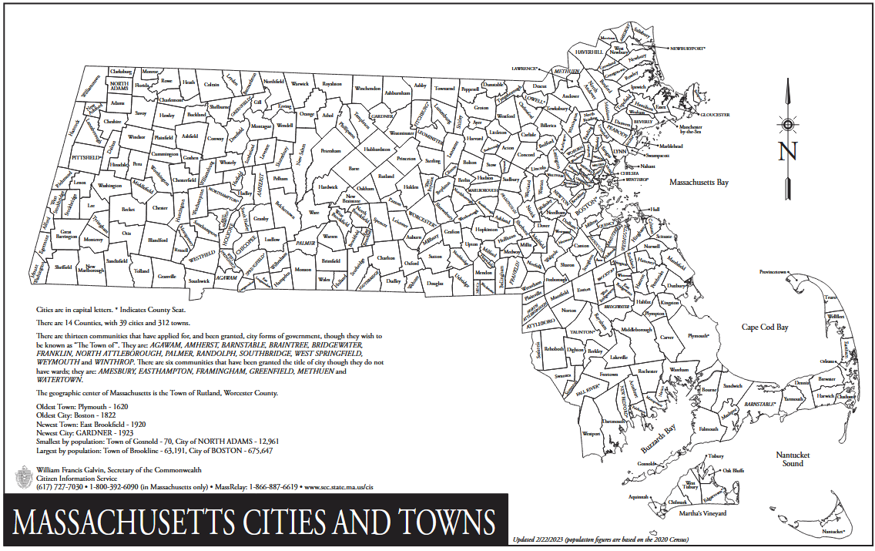
One Commonwealth
351 Cities and Towns

Slide 4

Today’s Agenda
Making a Defendable Decision
Additional Open Meeting Law considerations
Applicability of Conflict of Interest Law
Overlap with Public Records Law

Slide 5

Role of Robert’s Rules
Robert’s Rules of Order
A helpful – but not required – guide for conducting your meetings
State law silent Robert’s Rules of Order
In very select cases, municipal rules require adherence
© 2026 KP LAW, P.C. All rights reserved.

Slide 6
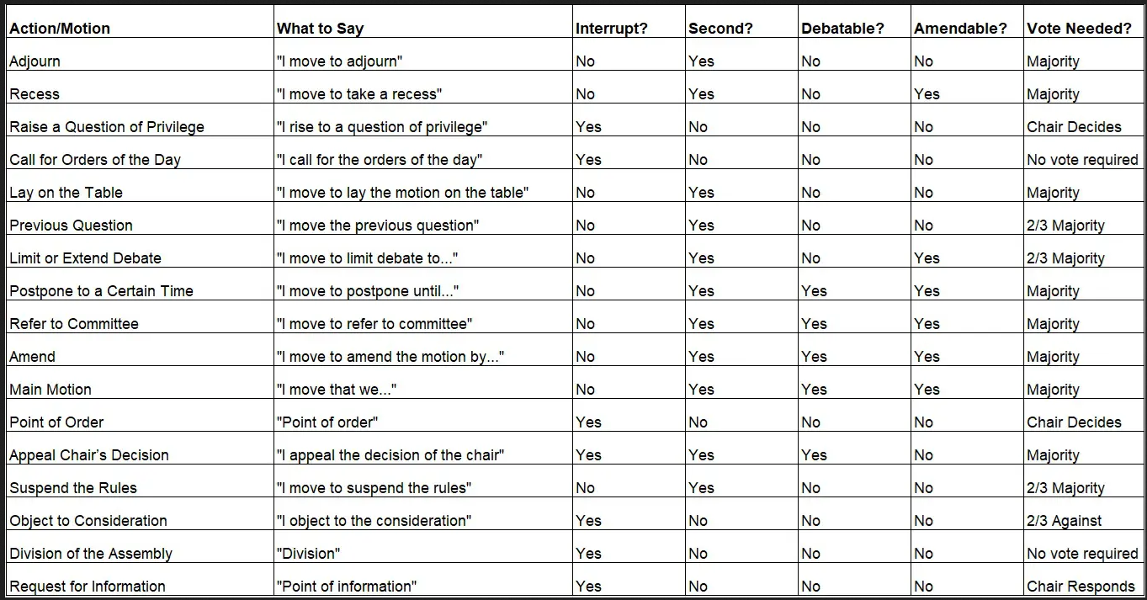
Disclaimer

Slide 7

Role of Robert’s Rules
Robert’s Rules of Order
Common sense is best
Chair is in charge (like under the Open Meeting Law)
Ask for a second before voting – ensures a minimum of support
  If you have a local rule that requires following Robert’s Rules, a second is not required
Ask for any further discussion between a second and the vote
© 2026 KP LAW, P.C. All rights reserved.

Slide 8
1. Making a Defendable Decision
Site Visits as Part of Public Hearing Process
On-site inspections are not a “meeting” that must be noticed under the Open Meeting Law, provided that members do not deliberate
    If deliberation is possible, post the site visit as a meeting of the Board
    If meeting is posted, remember that Board cannot invite members of the public onto private property without permission
ADA compliance for site visits (if posted meting) – terrain, construction

Slide 9
1. Making a Defendable Decision
Site Visits as Part of Public Hearing Process
Hold site visits prior to the close of the public hearing
Board to report findings/observations at next public hearing

Slide 10
1. Making a Defendable Decision
Location of Public Hearing
  OML and Americans with Disabilities Act requires that the location of the public hearing must be accessible to members of the public
  OML 2012-46: AG concluded that School Committee violated the OML where meeting was held in locked area of high school, and the public was unable to gain access to the meeting once the greeter left
  Practical considerations include:
  Do not move meeting to different location unless that alternative location is posted on meeting notice or clearly posted on door
  Ensure public can find/access meeting room

Slide 11
1. Making a Defendable Decision
Opening the Public Hearing
Confirm Board has a quorum (majority) and quantum to vote
Explain Board’s procedures to the public
Ensure the application, legal notice, and advertisement match
Read legal ad aloud to introduce the public hearing
Motion to Open Public Hearing
Track time to act and board members comprising panel

Slide 12
1. Making a Defendable Decision
Opening a Remote Public Hearing
If any member of the board will be remote, the AG requires additional steps:
  At the start of the meeting, the chair must announce the name of the member(s) who are participating remotely and such information must be recorded in the minutes
All votes must be taken by roll call
Members of the board must be clearly audible to each other and to the public at all times

Slide 13
1. Making a Defendable Decision
Conducting the Public Hearing
Announce process, who will speak first, etc.
  Chair has authority to remove disruptive people, but warn or take recess first
Applicant (or its counsel) to present
Board members to ask questions
Invite public comment and questions; Town officials
Give applicant opportunity to respond
Assess “room”, limit time of each speaker
Alternate between those in favor and those opposed for balance
Continue hearing if run out of time
Consider other applications on agenda

Slide 14
1. Making a Defendable Decision
Conducting a Remote Public Hearing
Do a practice run! Ensure that technology and speaking transitions run smoothly and that Chair or other host are comfortable
Designate chair or staff member as meeting “host” or moderator of chat
Encourage applicant and public to download remote platform in advance
Indicate on notice that public comments may be submitted by e-mail or by telephone, at specific email address and telephone number, until close of public hearing. Designate someone to monitor.
If Board will be conducting multiple remote public hearings over next few months, post Board’s processes in writing and post on website

Slide 15
1. Making a Defendable Decision
Conducting a Remote Public Hearing
At start of meeting, chair should announce:
  A telephone call-in number in case anyone experiencing technical difficulties may call into the hearing
  Ask all participants to “mute” their microphones unless speaking
  All speakers to be recognized by Chair; only one speaker at a time
  Procedures to be recognized (“raise a hand” feature on zoom; monitor calls)
  Chair may “mute” or “remove” disruptive individuals who do not adhere to the guidelines (but warn or take recess first)

Slide 16
1. Making a Defendable Decision
Conducting a Remote Public Hearing
Remember that there is often a delay; speak slowly and pause
The chair decides how to address technical difficulties
  AG encourages public bodies to suspend discussion while technical issues are addressed, particularly if they affect ability to see and be heard
  If remote participant is disconnected from the meeting, that fact and the time at which the disconnection occurred must be noted in the meeting minutes
Board members may not chat/text/email privately
  All of Board’s deliberations must be open and audible to the public
  Just like “no whispering” during physical public hearings
All documents/presentations should be made available on screen during hearing and noted in meeting minutes

Slide 17
1. Making a Defendable Decision
Conducting the Public Hearing
Can use outside consultants (obtain technical expertise you need to evaluate application, paid by applicant) pursuant to G.L. c.44, §53G
  But must first promulgate rules under G.L. c.111, §31
Motion to close public hearing (majority vote)
  Before closing, ask if anyone has additional information to submit
  Once closed, no further public comment or documents may be received

Slide 18
1. Making a Defendable Decision
Determine Who Can Vote
Mullin Rule: G.L. c. 39, §23D – if board member misses single session of hearing, must certify in writing that all evidence from missed hearing was reviewed before that member may vote. If more than one session missed, board member disqualified from voting.
Requires local acceptance

Slide 19
1. Making a Defendable Decision
Best Practices for Vote
Include in the motion:
  Identify applicant/property owner and address of site;
  Jurisdictional basis for decision (statute, bylaw, regulation, or policy);
  Findings of fact required under applicable statute or bylaw;
  All required determinations of law and reasons for the decision; and
  Language that “any relief not expressly granted hereunder is hereby denied.”

Slide 20
1. Making a Defendable Decision
Best Practices for Vote
Board deliberates and discusses rationale in open session
Take votes to make findings based upon the applicable statute, bylaw, or regulations
Take votes to approve, approve with conditions, or deny application
All votes to make decision must be by roll call if any member remote
  Include all conditions and requirements for approval in the motion
  No vote may be by secret ballot per Open Meeting Law, G.L. c. 30A, § 22(b)

Slide 21
1. Making a Defendable Decision
Make a Defensible Decision
  Don’t say: “The retail tobacco permit shall be revoked.”
  Do say: “The retail tobacco permit shall be revoked because (1) tobacco was sold to minors, (2) the retailer failed to comply with the Board’s regulations, and (3) the retailer did not provide evidence of improved procedures .”

Slide 22
2. Additional Open Meeting Law Considerations
Provide Proper Notice
  General rule established by the AG is that notice must include sufficient specificity for a reasonable member of the public to read the topic and understand the anticipated nature of the discussion
  OML 2011-11: Notice for Soil Board hearing was deficient where it listed “Renewal of Fall Soil Permits,” as it reasonably anticipated that specific permits would be considered and “it should take the additional step of listing … the details of those specific permits, including the name of the applicant and the location under consideration.”

Slide 23
2. Additional Open Meeting Law Considerations
Provide Proper Notice
  Examples:
    For a Monday hearing, notice must be posted on Thursday
    If Monday is a legal holiday, a Tuesday hearing also must be posted on Thursday
  Town Clerk should time stamp notice to ensure record exists of filing
    Ensures that the public body’s substantive decisions cannot be collaterally attacked for minor procedural errors
  If posting is made in an “alternate location,” notice must be timely posted in both locations

Slide 24
2. Additional Open Meeting Law Considerations
Avoid “Deliberation” Violations
  Deliberation: “an oral or written communication through any medium, including electronic mail, between or among a quorum of a public body on any public business within its jurisdiction…” G.L. c.30A, §18.
  Specifically includes:
    E-mail and text messages
    Serial conversations
    Beware of social media posts
  Specifically excludes:
    Distribution of agenda and meeting materials, reports, or documents that may be discussed, so long as no member expresses an opinion on the document
    Scheduling information

Slide 25
2. Additional Open Meeting Law Considerations
Avoid “Deliberation” Violations
Do E-mail:
  regarding availability for meetings
  to distribute packet of materials to be discussed at public meeting, but do not comment on materials
    If materials distributed via e-mail, must be available to the public
Don’t E-mail:
  Any opinion or thoughts on pending topic or application
  Open question, such as “How do you intend to handle...?”
  “If you ask me, I think the area is too densely developed…”
  “We don’t need another…”
  “There’s no way I will vote for a ...”

Slide 26

2. Additional Open Meeting Law Considerations
Avoid “Deliberation” Violations (Emergencies)
Limited instances only.
Poor planning is not an emergency!
Natural disasters, weather events, public health issues will create emergencies.
If meeting in an emergency, comply with OML to the extent possible, including posting, taking minutes; consider simultaneously posting for a meeting that will meet the requirements of the OML

Slide 27
3. Applicability of Conflict of Interest Law
Act Early – Resolve Questions Prior to Vote
Municipal employees and board members must receive a summary of conflict of interest law
Municipal employees and board members must complete an online training program: www.ma.gov/ethics
Recuse yourself if:
  You have a financial interest in the matter
  You are related to the applicant
  You are an abutter or a close resident to subject property
  You have any bias
  If unsure, ask TA for opinion from Town Counsel

Slide 28
4. Overlap with Public Records Law
What is a “public record?”
Includes all records “made or received” by a governmental body, official, or employee, unless specifically exempted
Includes:
    Letters, notes, memoranda, photos, audio recordings, and data
    E-mails, texts, social media posts, and other electronic communications, even if sent from a personal e-mail account or personal cell phone

Slide 29
4. Overlap with Public Records Law
What is a “public record?”
All documents in the file for an application are public records, unless there is an explicit exception or exemption that applies, such as:
    Attorney-client privilege, internal memoranda related to ongoing policy positions being developed by Town, personnel files, etc.
Open Session minutes are public records even if not yet approved, unless there is an exception

Slide 30

Michael A. D’Ortenzio Jr., Esq.
KP Law, P.C.
101 Arch Street, 12th Floor
Boston, MA 02110
617.556.0007
mdortenzio@k-plaw.com

Slide 31


Thank you!
© 2026 KP LAW, P.C. All rights reserved.

