Slide 1


Damon Chaplin, Health Commissioner
Minneapolis Health Department
NACCHO President 2025-2026
August 6, 2025

Slide 2


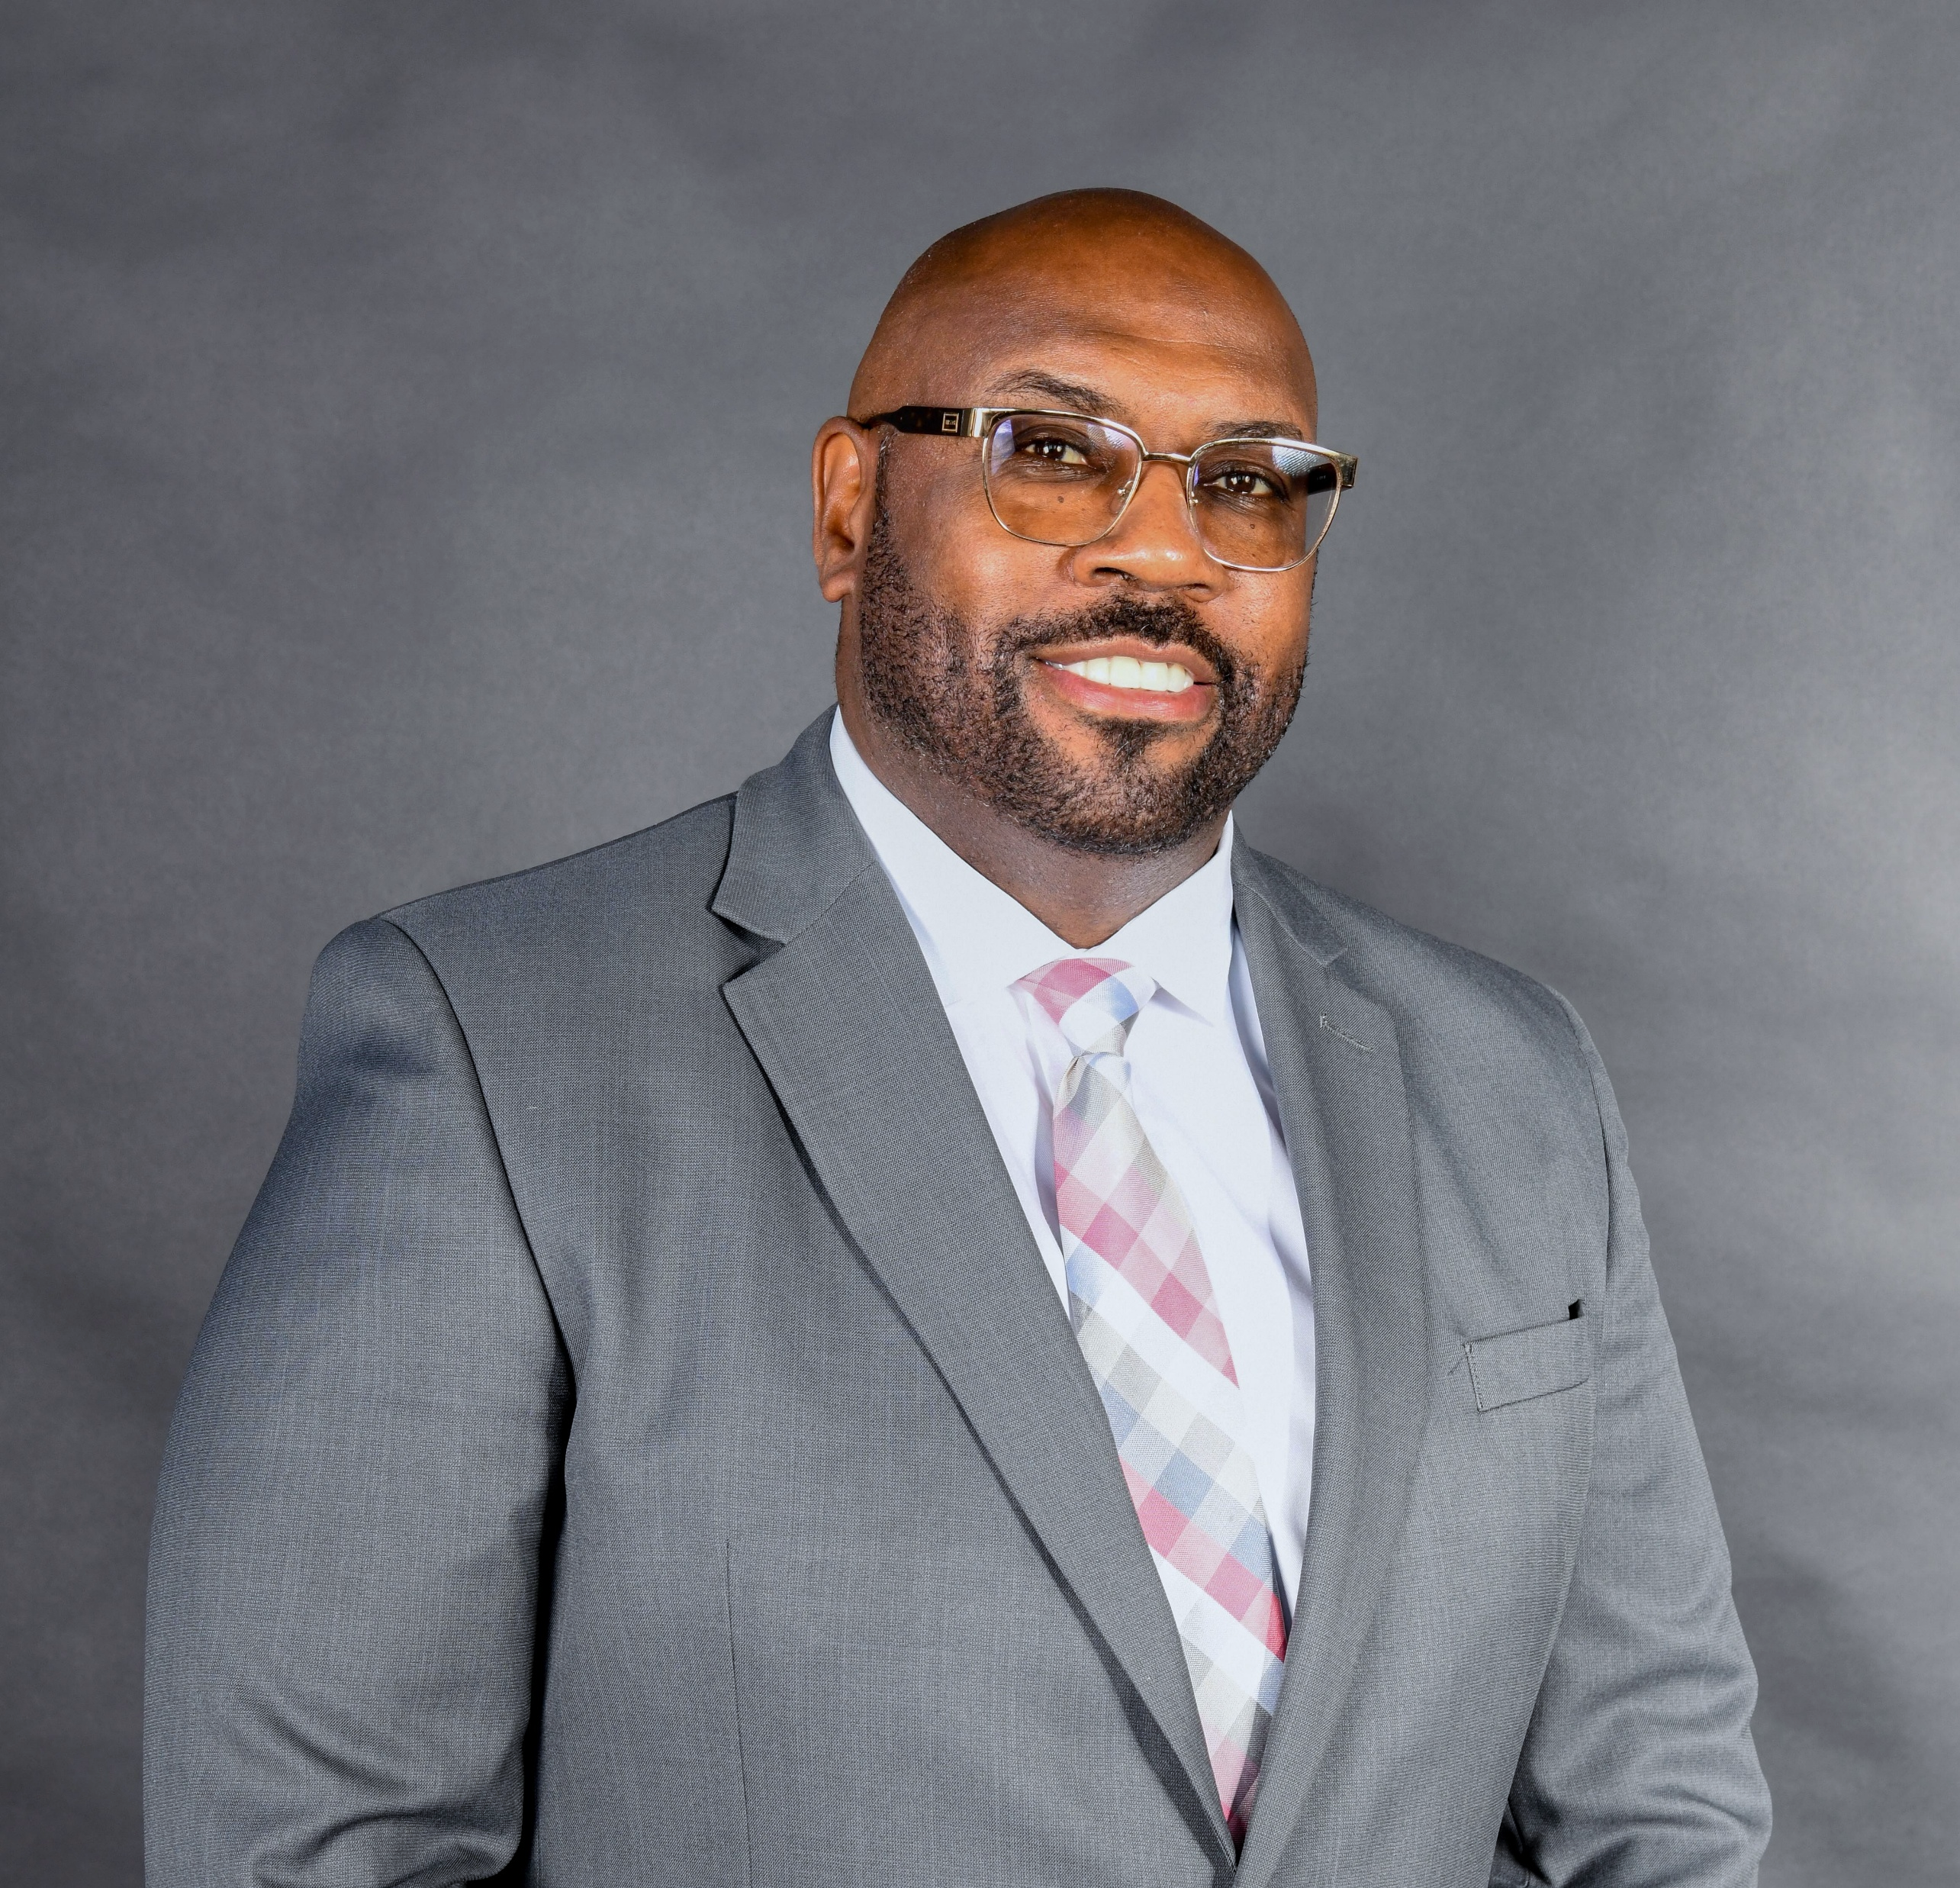
Beginnings in Massachusetts: My Public Health Origin Story
Notes:
The start of a public health career often shapes future paths. This section covers initial motivations, mentors who guided the journey, and early challenges faced in Massachusetts local public health roles.

Slide 3



What were the most valuable experiences during your time in MA?
“We are the Calvary”
Insights and Reflections:
A story of Teamwork, Resiliency and Strength
Valuable Lessons learned from Covid-19
Ask Powerful Questions
Holding people accountable
Value the importance of social capital
Notes:
What were the most valuable experiences during your time in MA?
tent may be incorrect.
---
This presentation shares a personal journey through local public health work, beginning in Massachusetts and progressing to roles in Minneapolis, San Antonio, and NACCHO. It highlights experiences, lessons learned, and advice for those interested in advancing in the public health field.

Slide 4




Missed.……Opportunities?
Data
Social Strategy
Political Will
Notes:
Were there any opportunities or missed opportunities that the audience should take advantage of now as part of their professional growth?
---
Motivations included a passion for community health and a desire to make tangible impacts. Entry into the field involved navigating public health systems and learning foundational skills in local health departments.
Image source: Microsoft 365 content library

Slide 5
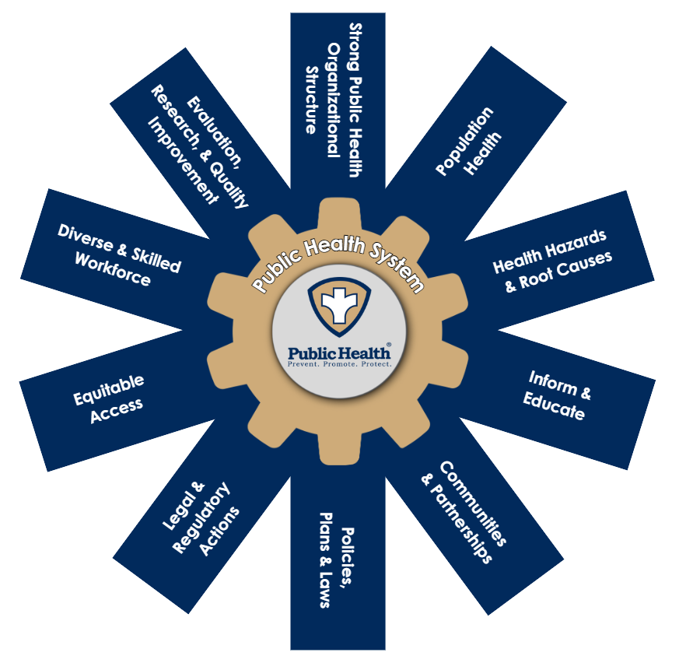
Why our work is important
A system works due to how its parts connect and affect each other—
not just what each part does on its own.
Like any system,
the Public Health System
can't do its job
if a part is missing, cut off from others, or not funded.
Governmental Public Health is the Vanguard of the System
Notes:
Wrap up with words of encouragement explaining why our work in local public health is important

Slide 6
Conclusion
Value of Diverse Experiences
Diverse experiences enrich understanding and effectiveness in public health work.
Continuous Learning Importance
Ongoing education supports adapting to challenges and advancing public health goals.
Embracing Challenges and Opportunities
Accepting challenges fosters meaningful community impact and professional fulfillment.
Notes:
This journey through local public health highlights the value of diverse experiences, continuous learning, and dedication. Embracing challenges and opportunities leads to meaningful community impact and professional fulfillment.

