Slide 1

Demystifying local public health changes in Massachusetts
July 9, 2025 cheryl Sbarra, esq.
Massachusetts Association of health Boards

Slide 2

Disclaimer
This information is provided for educational purposes only and is not to be construed as legal advice.
MAHB does not enter into attorney client relationships.

Slide 3
History
Coalition of Local Public Health in 2006
  Massachusetts Health Officers Association (MHOA)
  Massachusetts Association of Boards of Health (MAHB)
  Massachusetts Association of Public Health Nurses (MAPHN)
  Massachusetts Environmental Health Association (MEHA)
  Massachusetts Public Health Association (MPHA)
Coalition for Local Public Health today includes:
  Western Massachusetts Public Health Association (WMPHA)
  MPHAs new name: Massachusetts Public Health ALLIANCE

Slide 4
History
Survey conducted by Justine Hyde on behalf of CLPH in 2006
Findings:
  All Boards of Health are required to provide or assure access to an identical set of services.
  Health Departments stretched too thin since the 9.11 terror attack.
  More than 70% report they do not have staff to meet obligations.
  Budgets have not kept up to inflation.
  Some municipalities are forced to perform public health triage.
    Providing only those services deemed most essential or engender the greatest sense of urgency.
  Striking disparity in public health resources available to smaller municipalities, especially in Western Mass.

Slide 5
Survey results - continued
Nearly 1/5 of workforce eligible to retire in next two years.
Health inspectors and public health nurses in short supply.
Qualification and salaries for public health personnel vary dramatically among municipalities.
Elected and appointed board of health members have limited formal training.

Slide 6
Public Health Working Group - 2006
Co-Chairs: Harold Cox, BUSPH and Judith Kurland, Office of Mayor Thomas Menino
Members:
  Kathy Atkinson, DPH
  Kerry Dunnell, Cambridge Health Alliance
  John Greib, Cambridge HealthAlliance
  Jennifer Infurna, Office of Rep. Peter Koutoujian
  David Johnson, Office of Senator Susan Fargo
  Richard Lehan, DEP
  Cheryl Sbarra, MAHB
  Frank Singleton, Lowell Health Department
  Phoebe Walker, Franklin Regional Council of Governments
  Geoff Wilkinson, Massachusetts Public Health Association

Slide 7
The Work
Research:
  Cities and towns that had longstanding cooperative agreements.
  Public health emergencies without boundaries
    Anthrax
    West Nile virus
    Hepatitis A outbreaks
  MTCP tobacco collaboratives
  Practice in other states
  Maintaining and preserving legal authority of each board of health
Crossed the state giving presentations about what boards of health did and why we needed to consider changing the way we delivered services to assure every resident in MA received the same level of services regardless of where they lived.
Not always well-received.

Slide 8
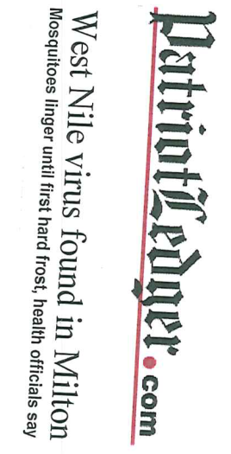
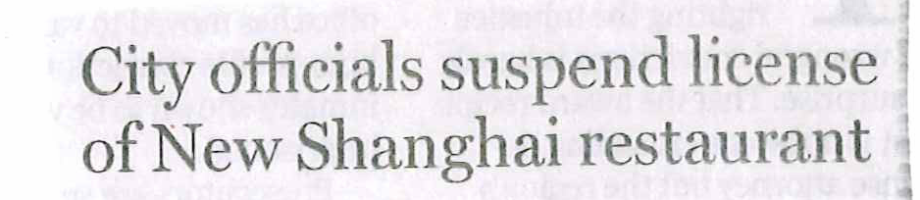
Public Health in the News Everyday - 2008
Third Man confirmed dead from Whittier Farms Milk contamination
S. Boston house of squalor condemned
City gives owners 30 days to clean
SENATE PASSES TRANS FAT BILL
Notes:
We want to amplify what local public health efforts are and what the consequences are for cities and towns when public health codes are not properly implemented or resourced….

Slide 9
Working Group’s Recommendations 2007
Develop various model organizational structures.
  One size won’t fit all.
  Respect, support and accommodate existing structures.
  Respect historical relationships.
Develop set of governing principles.
  Understand roles and responsibilities.
  Understand legal authority of boards of health.
Adequately fund organizational structures.
Develop performance standards.
Assure all districts can meet regulatory and statutory requirements.
Build on existing legislation to do this work.

Slide 10
Legal and Legislative Work
Convinced the legislature to amend Chapter 111, Sec. 27A (Appointment of Health Officer by Two or More Towns) to require a vote of the local board of health.
  Prior to this amendment, the decision to form a public health district was solely decided by the Select Board, the Mayor, or the City Council.
Legal authority of local boards of health is/was always a priority.
Researched employee protections when working in another municipality.
Researched intergovernmental agreements (IMAs) for other services.
Researched informal agreements (MOUs).
Continued to talk with public health colleagues.

Slide 11
Chapter 3 of the Resolves of 2016 Establishing the Special Commission of Local and Regional Health
Assess the effectiveness and efficiency of municipal and regional public health systems;
Make recommendations on how to strengthen the delivery of public health and prevention measures.
Examine capacity of local and regional public health authorities in comparison with national public health standards and recommendations from:
  CDC, PHAB, NACCHO, NALBOH, ASTHO and other relevant organizations.
Driven largely by the Mass. Public Health Alliance and CLPH.

Slide 12
Charge of Commission (cont.)
Assess capacity of local public health to carry out statutory and regulatory obligations;
Evaluate local and state resources;
  Assess per capita funding levels within municipalities
Evaluate workforce credentials of current and future public health workforce;
Assess current capacity of the Office of Local and Regional Health at DPH; and
Hold hearings and receive testimony.

Slide 13

Findings of Special Commission
Many cities/towns were unable to meet statutory and regulatory requirements.
More health departments than any other state (351).
Unable to keep up with growing list of duties.
No comprehensive way for DPH to collect public health inspection data.
No workforce standards or credentialing.
Funding inconsistent across the Commonwealth.

Slide 14
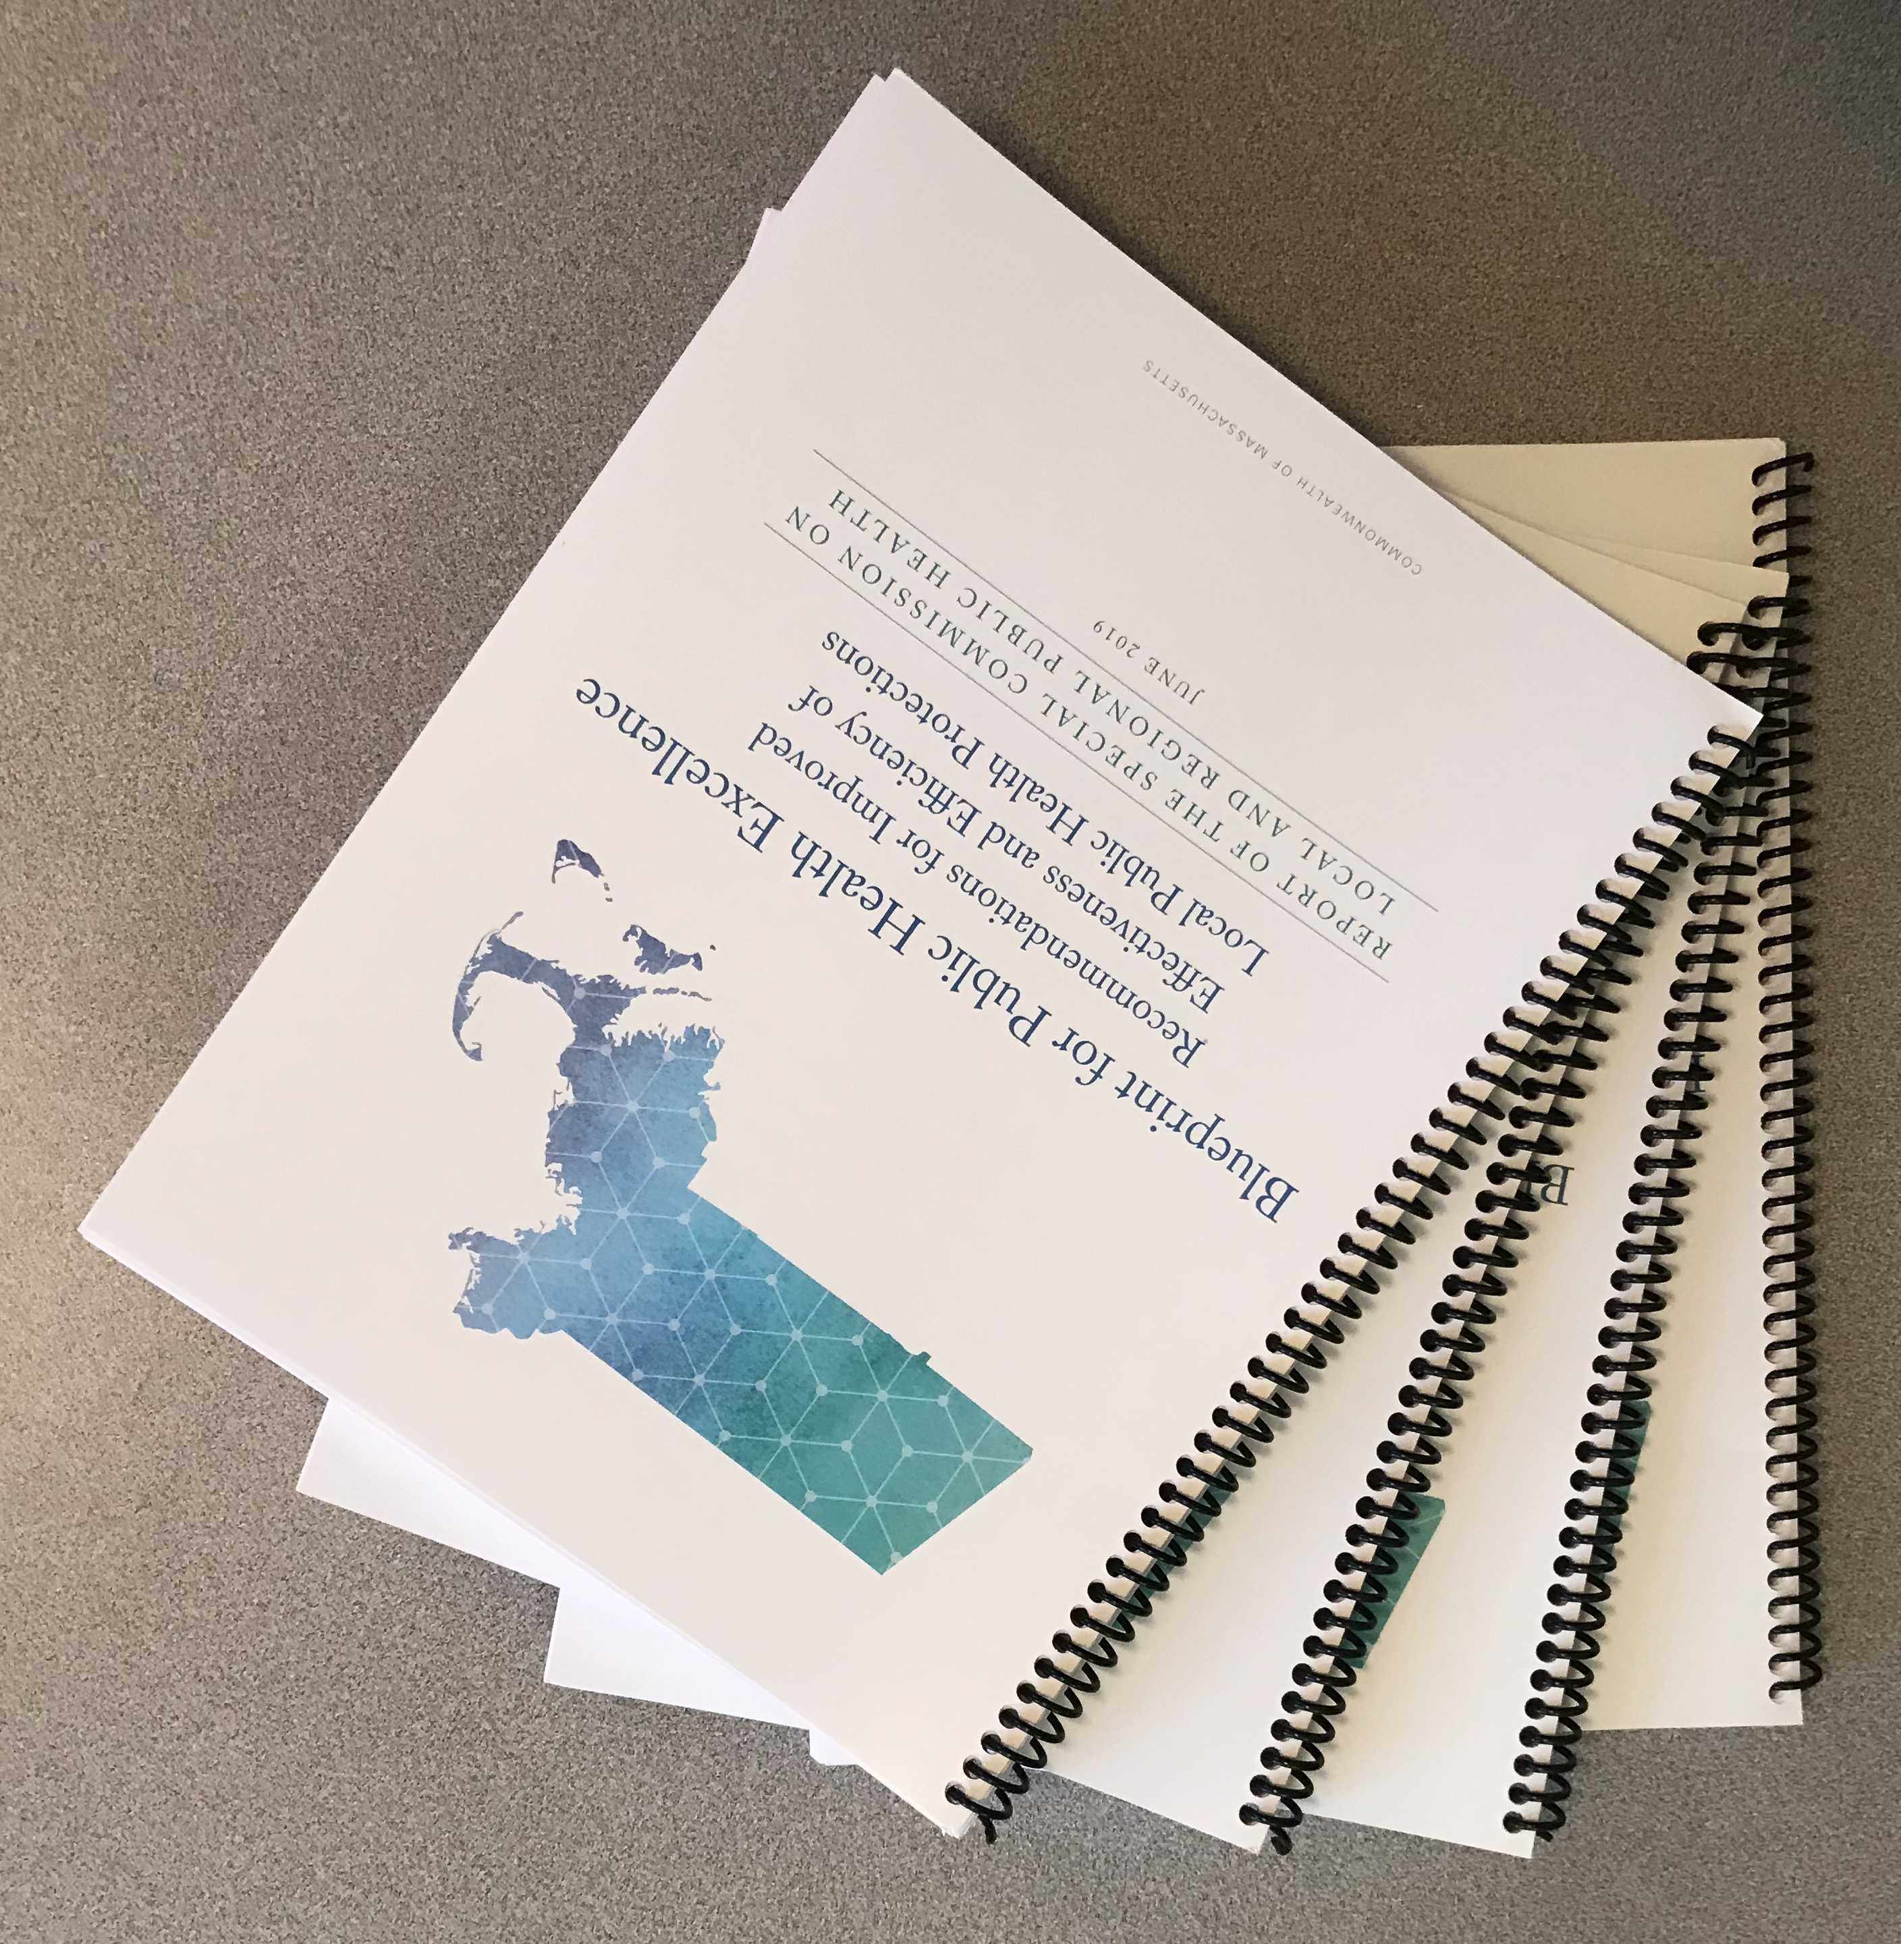
Blueprint Published - 2019
Report of The Special Commission on Local & Regional Public Health: “The Blueprint:”
Finds that Local Public Health is broken and makes recommendations for strengthening local public health services and protections across the Commonwealth.
These recommendations were first codified by the Legislature in 2021 and strengthened in December of 2025. (MGL c. 111, §27D).

Slide 15
Findings of Special Commission (cont.)
Lacking in what most states considered minimum standards.
Data collection needed improved reporting and gathering capacity.
No minimum standards of qualification for public health workforce.

Slide 16
Blueprint Published
Report of The Special Commission on Local & Regional Public Health: “The Blueprint:”
Finds that Local Public Health is broken and makes recommendations for strengthening local public health services and protections across the Commonwealth.
These recommendations were first codified by the Legislature in 2021 and strengthened in December of 2025. (MGL c. 111, §27D).

Slide 17
COVID 19 & SAPHE 1.0 LEGISLATION
G.L. c. 111, § 27D
State Action for Public Health Excellence
Required DPH to establish a program to encourage boards of health to adopt practices to improve the efficiency and effectiveness of the delivery of public health services.
Public Health Excellence Grant Program created.

Slide 18

PASSAGE OF SAPHE 2.0
Not a yellow brick road

Slide 19
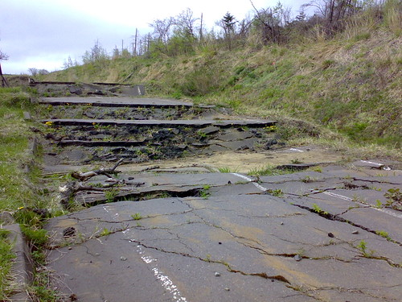
Rather a long, bumpy, and uncertain road
2021 – 2022 legislative session:
  Legislature held numerous public hearings.
  Subject of many State House rallies.
  Massive educational component for Legislators and others.
  Passed unanimously on last day of session by House and Senate.
  Sent to Governor Baker’s desk for his signature.

Slide 20

BUT
Governor Baker sent it back with an amendment that would have made the law optional for cities and towns.
Would have defeated purpose of law.
MMA?

Slide 21
Coalition for Local Public Health (CLPH)
2023 – 2024 legislative session
  Worked with legislative champions’ staff to amend language confirming that the law was SUBJECT TO APPROPRIATION.
  Mass. Municipal Assoc. claimed it was an unfunded mandate.
  Dragged on through entire session.
    Many ups and downs throughout
  Signed by Governor at very end of session as part of the Economic Development Act.

Slide 22
G.L. c. 111, § 27D
An Act to Accelerate Equity & Effectiveness of Our Local & Regional Public Health System.
a/k/a Statewide Accelerated Public Health for Every Community Act or SAPHE 2.0.
Codifies the Report of the Special Commission on Local and Regional Public Health.
PHE programs are created pursuant to § 27D.

Slide 23
SAPHE 2.0 (G.L. c. 111, §27D)
DPH must establish the State Action for Public Health Excellence program to:
  Encourage BOHs to adopt practices to improve the efficiency and effectiveness of the delivery of public health services.
  Lead with addressing issues of equity for historically underrepresented municipalities, health disparities and bringing adequate resources to BOHs so they can meet the objectives of the law.
    Including increasing cross-jurisdictional sharing, improved data collection and reporting, workforce credentialing, expansion of professional development, training and technical assistance support for all municipal and regional public health collaboratives.

Slide 24
Mandates New Standards for the Following:
Inspections
Epidemiology and communicable disease investigation and reporting
Permitting, and other local BOH responsibilities required by law or regulations imposed by DPH or DEP
Workforce education, training and credentialing
Inputting required data in data collection system

Slide 25
Local Board of Health Obligations
Implement and comply with new standards
Shall submit a report annually which demonstrates compliance no later than August 31st of each year beginning August 2027.
If a BOH is not performing in compliance with the law, the BOH shall be notified in writing and describe what corrective actions it will take.
If DPH is not notified, or determines that such actions are insufficient, DPH may restrict future funding.

Slide 26
DPH/DEP Training and Funding Obligations
Shall provide comprehensive core public health education and training and technical assistance to BOHs and their staff to obtain credentials in any of the areas regulated and DPH/DEP –
  In geographically convenient areas, and
  Free of charge.
DPH and DEP shall provide funds to BOHs to implement and comply with standards developed pursuant to §§ 27(b) and (c) through cross-jurisdictional sharing of public health programs through comprehensive public health districts, formal shared services agreements, and other public health sharing programs.
Grant opportunities shall be made available to supplement programs.

Slide 27
Training and Funding Obligations (cont.)
DPH and DEP must develop a system to measure the effectiveness of:
  Inspections
  Code enforcement
  Communicable disease management
  Local regulations
DPH must assess and report the amount of funds necessary to do this to the Legislature.
DPH shall coordinate the reporting and response and the handling of all reporting data.

Slide 28
DPH/DEP Reporting Obligations
Bi-annual reporting is required by DPH and DEP on the status of the SAPHE 2.0 program and compliance with standards, including:
  The number of BOH members and staff that have met the standards;
  The number of boards and collaboratives that have complied with the standards; and
  The number of municipalities involved in shared services collaboratives.
    Requires BOH and Shared Services Arrangement cooperation/partnership.

Slide 29

Nothing in this law shall limit the authority of the board of health

Slide 30

Questions/Comments?

